Slide 1
CYBERSECURITY INTERNSHIP
WEEK 5 ASSIGNMENT
VAPT TOOLS: PRACTICAL LEARNING
Submitted by
Name: Deepashree.C
Role: Cybersecurity Intern
Week: Week 5
SIN: DG/SEPTEMBER/CYBER/254
Submitted to: DG Interns Hub
Submission date: October 2026
Topics covered:
VAPT Tools:
o Network Scanning– Nmap
o Web Vulnerability Assessment– Nikto
o HTTP Traffic Analysis– Burp Suite

Slide 2
VAPT OVERVIEW
Objective:
To understand the basic Vulnerability Assessment and Penetration Testing (VAPT) process through hands-on
testing of an authorized training website.
VAPT Workflow:
Target Identification → Network Scanning → Web Assessment → Traffic Analysis → Finding Documentation
Practical Objectives:
Perform network scanning using Nmap.
Identify open ports and available services.
Perform web-server assessment using Nikto.
Intercept HTTP requests using Burp Suite.
Analyze HTTP requests, headers, and web traffic.
Document security findings based on actual scan evidence.
Practice responsible and authorized security testing.

Slide 3
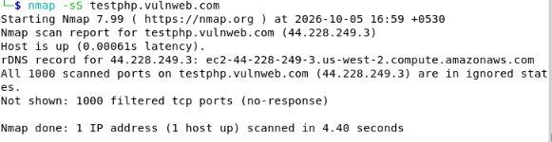
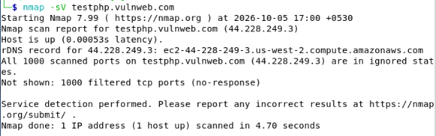
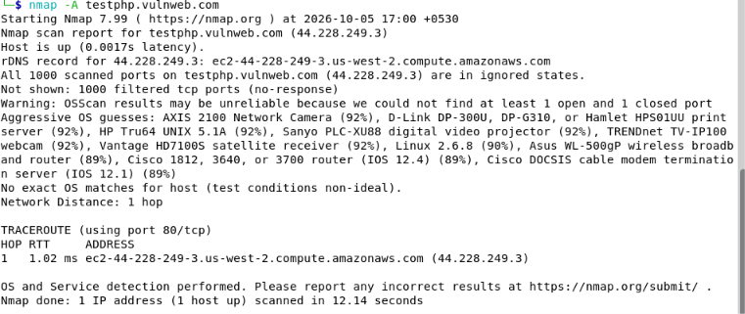
NMAP: NETWORK SCANNING
Nmap (Network Mapper) is an open-source network scanning tool used to discover hosts,
scan ports, and identify services running on a network.
Commands Used:
nmap -sS testphp.vulnweb.com – TCP SYN scan
nmap -sV testphp.vulnweb.com – Service/version detection
nmap -A testphp.vulnweb.com – Advanced scanning
Key Observations:
Target host was detected as up.
Scanned ports appeared filtered/no-response.
Service detection was limited due to missing TCP responses.
Possible Reasons:
Firewall filtering
Network ACL/security rules
Intermediate network filtering
Packet dropping
Conclusion:
Network filtering prevented complete port and service identification.

Slide 4
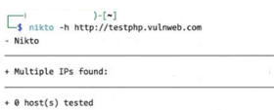
NIKTO: WEB VULNERABILITY SCANNING
Nikto is a web-server security scanner designed to detect potential security issues such as server misconfigurations, insecure files, outdated software components, and other commonly known web-server vulnerabilities.
Command Used:
nikto -h http://testphp.vulnweb.com
Scan Results:
Nikto successfully resolved the target hostname.
Multiple network addresses were identified for the specified target.
However, 0 hosts were tested during the scan.
Since no hosts were successfully tested, no web-server vulnerabilities were identified or reported by Nikto in this scan.
The absence of reported vulnerabilities should not be interpreted as confirmation that the target is completely secure, as the scan did not successfully test a host.

Slide 5
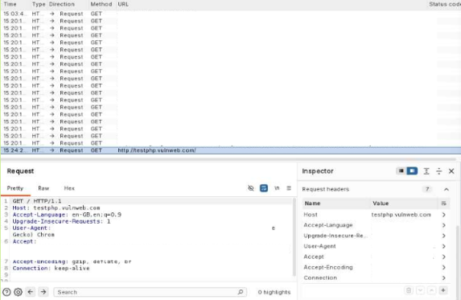
BURP SUITE: WEB APPLICATION SECURITY TESTING
Burp Suite is a web application security testing tool used to intercept and analyze HTTP/HTTPS traffic.
Proxy Configuration:
Proxy: 127.0.0.1:8080
Activities Performed:
Configured the local proxy listener.
Opened the authorized training website.
Captured and inspected HTTP requests.
Examined request methods, URLs, and headers.
Reviewed HTTP History.
Analyzed the captured request information.
Captured Request Information:
HTTP Method,Request Path,Host,User-Agent,Accept Headers,Connection Information

Slide 6
MINI VAPT TASK: FINDINGS & RESULTS
Key Findings:
Filtered TCP Ports – Nmap:The scanned TCP ports were identified as filtered, so Nmap could not determine whether they were open or closed.
Incomplete Web Scan – Nikto:Nikto successfully resolved the target, but reported 0 hosts tested. Therefore, no web-server vulnerabilities could be confirmed.
HTTP Traffic Analysis – Burp Suite: Burp Suite successfully captured and analyzed HTTP requests and headers, providing an understanding of web traffic and client-server communication.

Slide 7
CONCLUSION & LEARNING OUTCOMES
Conclusion:
The Week 5 practical provided hands-on experience with three VAPT tools: Nmap, Nikto, and Burp Suite.
The practical helped in understanding basic network and web application security testing.
Learning Outcomes:
Understood the basic VAPT methodology.
Performed network scanning using Nmap.
Learned to interpret filtered TCP ports.
Conducted a basic web-server assessment using Nikto.
Understood the significance of incomplete scan results.
Captured and analyzed HTTP requests using Burp Suite.
Learned to examine HTTP headers and web traffic.
Practiced basic security analysis and reporting.
Understood the importance of testing only authorized targets.

